Slide 1
Deformable Organism Model for Image Analysis
Ying Sun (Presenter 1)
Danfeng Guo (Presenter 2)
Wuyue Wu (Presenter 3)
Benlin Liu

Slide 2
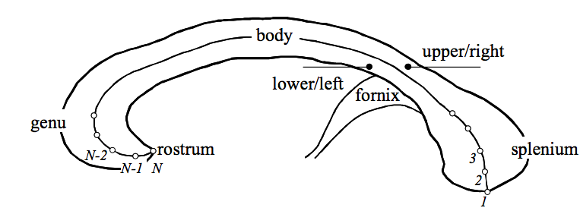
Introduction
New paradigm for automatic medical image
Adopting concepts from the field of Artificial Life
Segmentation and analysis of anatomical structures
T. McInerney and D. Terzopoulos, “Deformable Models in Medical Image Analysis: A Survey”, Medical Image Analysis, Vol. 1, No. 2, pp. 91-108, 1996.

Slide 3
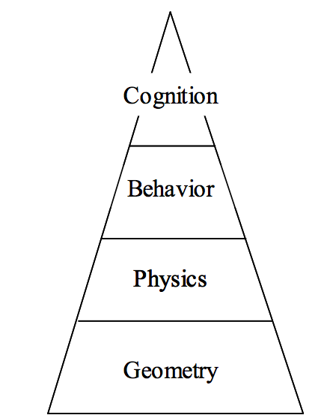
Artificial Life Modeling
The ALife modeling pyramid :
Geometric modeling layer -- morphology and appearance of the animal
Physical modeling layer -- incorporates biomechanical principles
Behavioral modeling layer -- support a reactive behavioral repository
Cognitive modeling layer -- simulates the deliberative behavior of higher animals

Slide 4
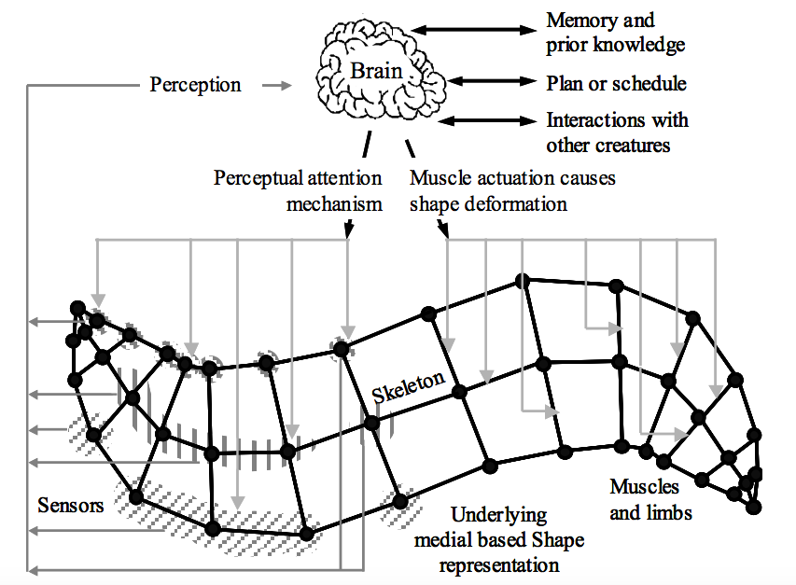
An Artificial Life Modeling Paradigm for Medical Image Analysis
Current approaches :
Geometric and physical modeling layers only
Do not monitor or control this optimization process
Inability to perform global deformations

Slide 5
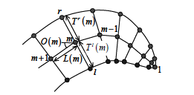
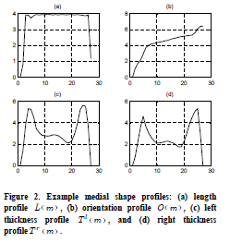
Shape Representation
Length L(m)
Orientation O(m)
Left thickness Tl(m)
Right thickness Tr(m)
One can control the shape by defining profiles.
Perform shape deformation by applying operators to profiles

Slide 6
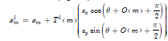
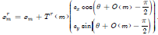
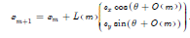
Shape Growing Steps
Define parameters
Put an initial node
For m = 1 : N
Compute the location of next left and right boundary points
Compute the location of next node

Slide 7
Sensors/Controllers
By how much the node grows
When the node stops moving forwards
How to find left/right thickness
Whether left/right node reaches the boundary
Can make use of image intensity, gradient map, preprocessed images, etc

Slide 8
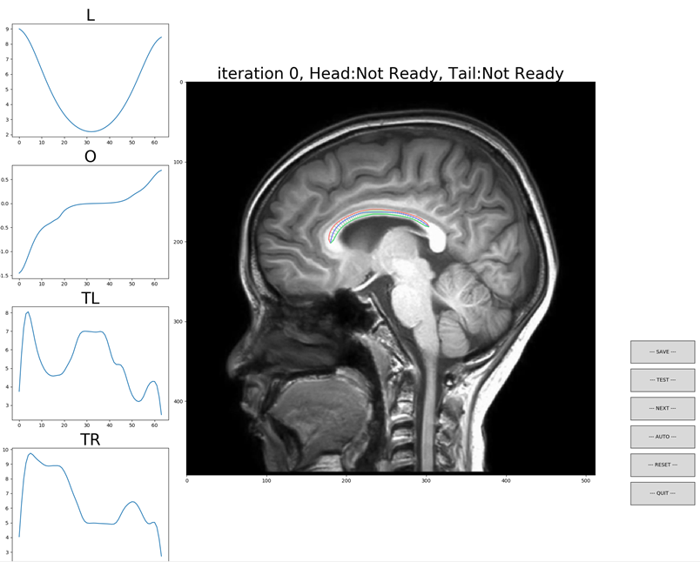
Our Model

Slide 9
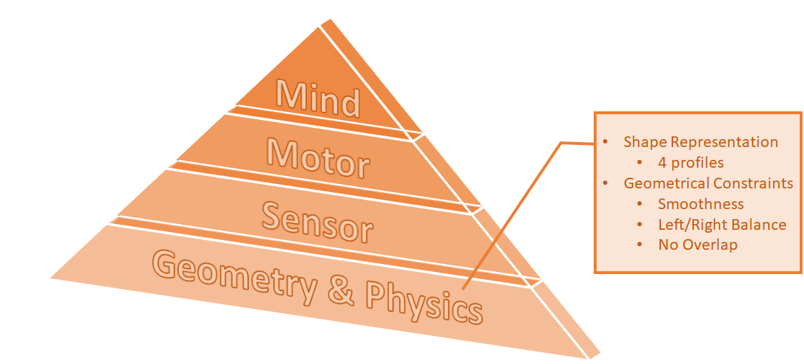
Model Hierarchy

Slide 10
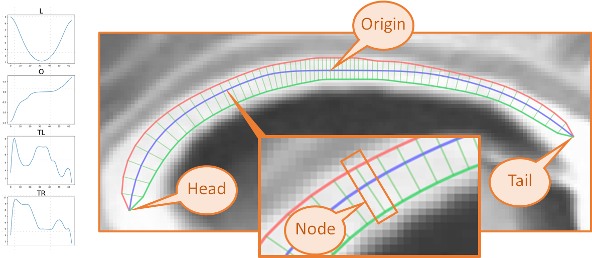
Geometry & Physics

Slide 11
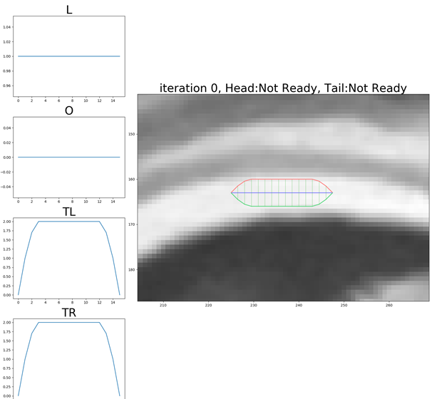
Geometry & Physics
Initial Profiles:

Slide 12
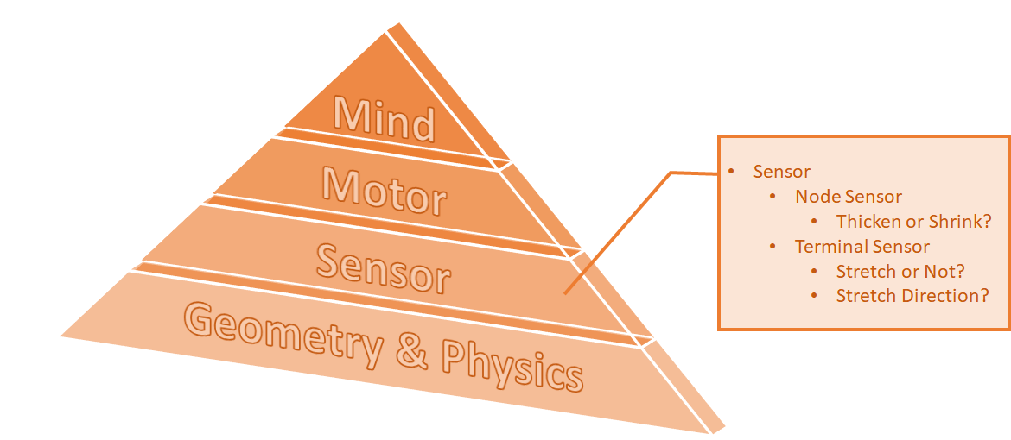
Model Hierarchy

Slide 13
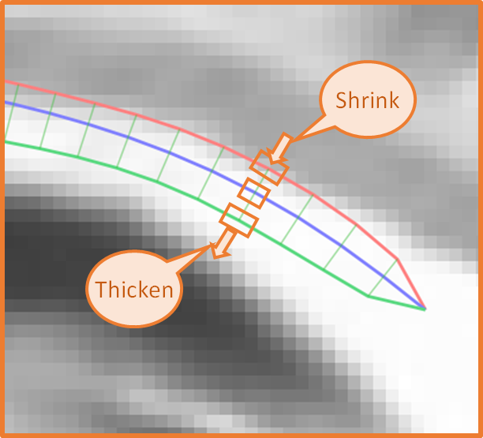
Sensor Example (Node)
Compare the color intensity of Middle, Left, Right positions of the node.
Tell the motor whether to thicken/shrink the node on left/right.

Slide 14
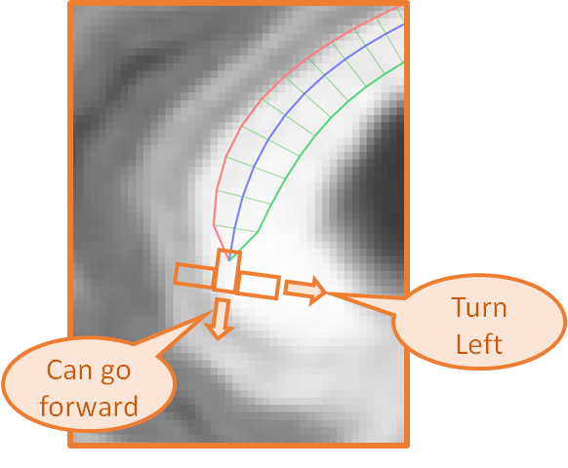
Sensor Example (Terminal)
Compare the color intensity of the front direction of the terminal node
Can the terminal go forward?
Compare the color intensity of the left/right direction of the terminal node
Should the terminal turn?

Slide 15
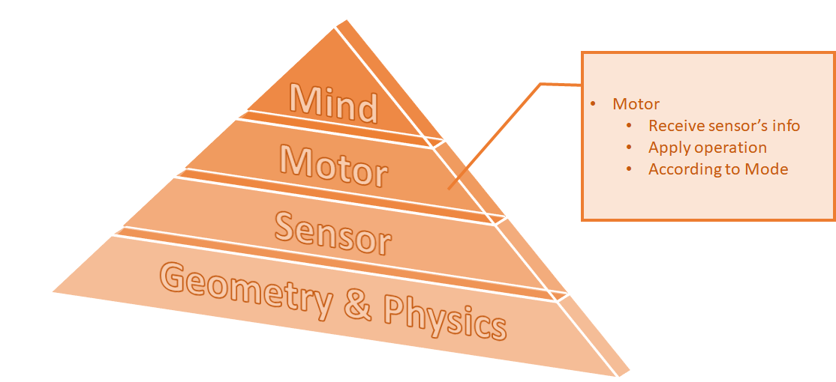
Model Hierarchy

Slide 16
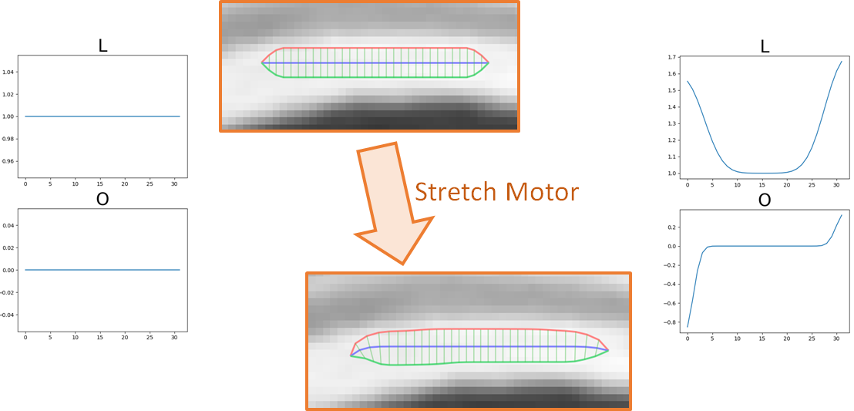
Motors

Slide 17
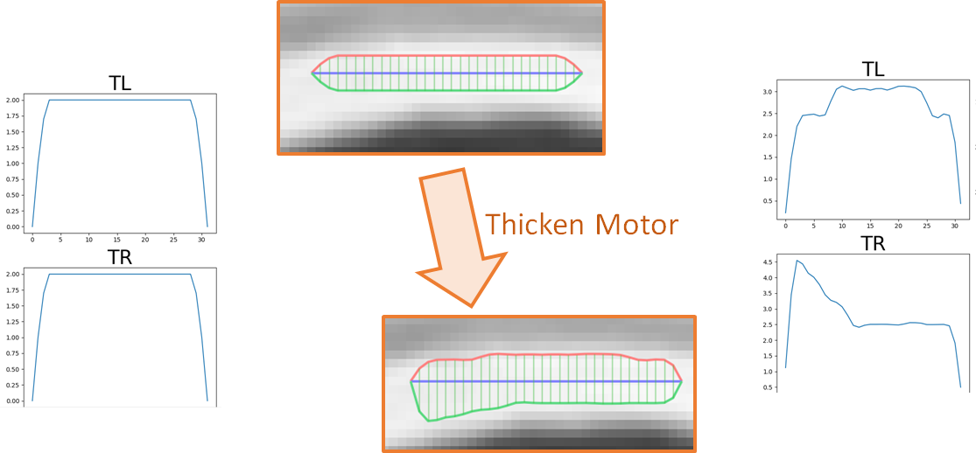
Motors

Slide 18
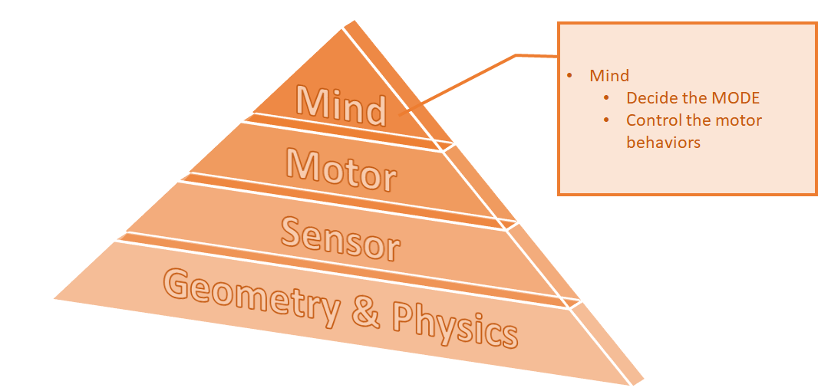
Model Hierarchy

Slide 19
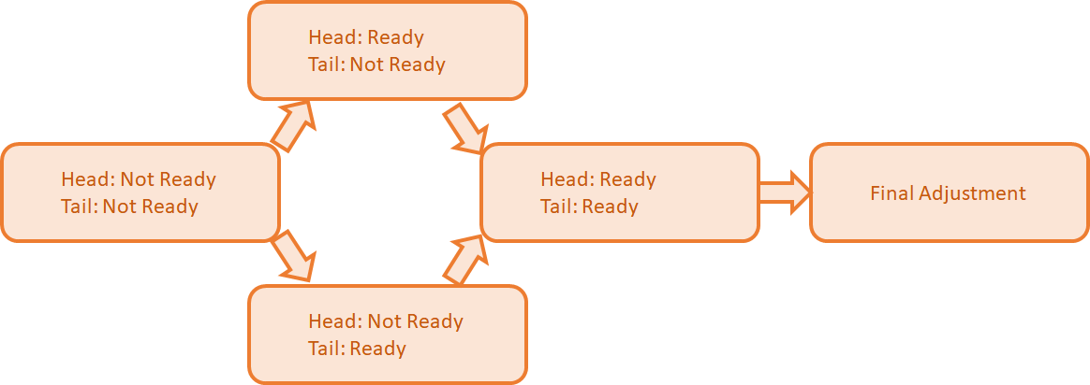
Modes

Slide 20
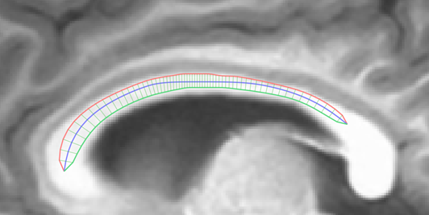
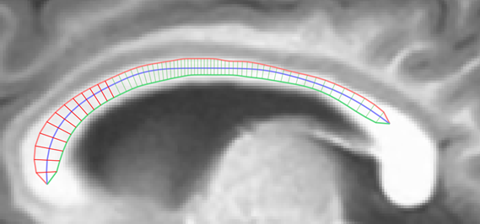
Terminal is READY
When a terminal is ready?
terminal has orientation angle > 90
After a terminal is ready,
Stretch strength reduced
Detect the border according to an eroded reference image

Slide 21
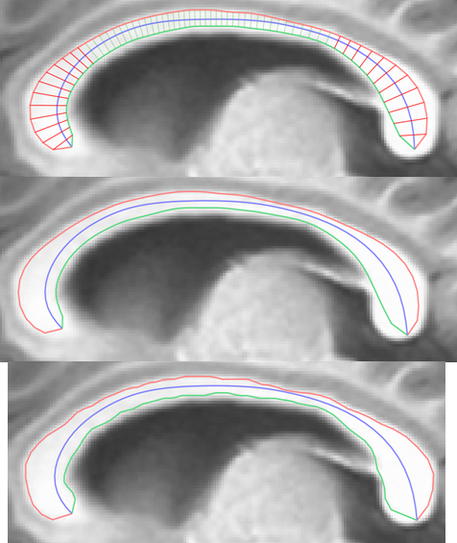
Final Adjustment
When get into Final Adjustment?
Both terminals are ready
No stretching for a while
In Final Adjustment,
Smoothing reduced
No more stretching
Encourage thickening

Slide 22
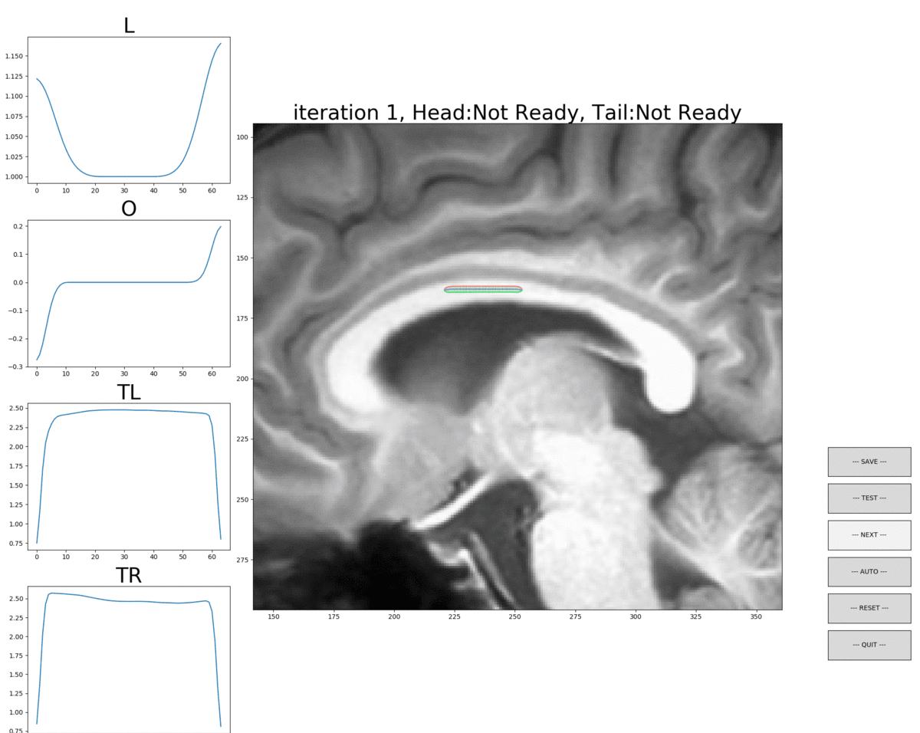
Result

Slide 23
Thanks

